Slide 1
Catherine Gaskell
Ford Engineer

Slide 2
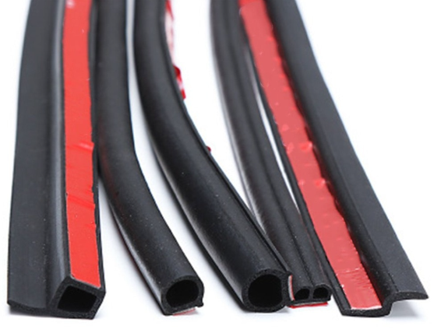
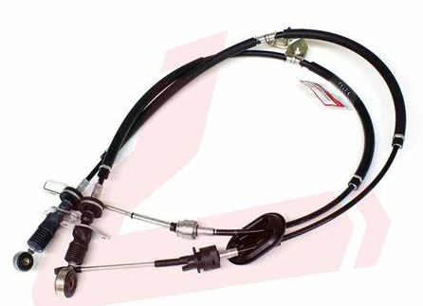
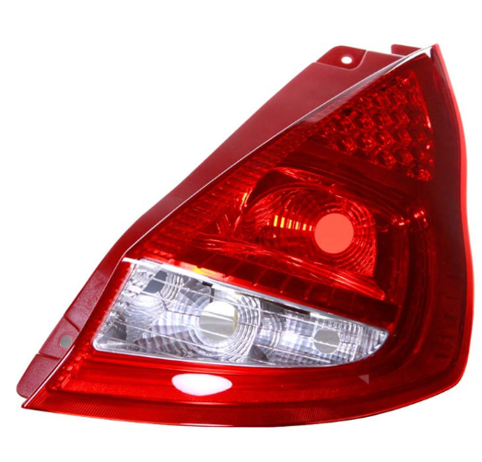
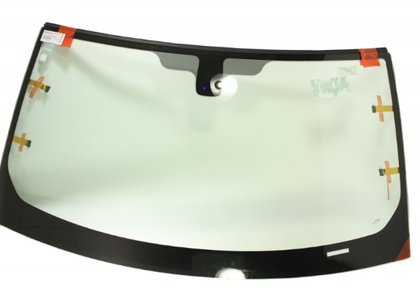
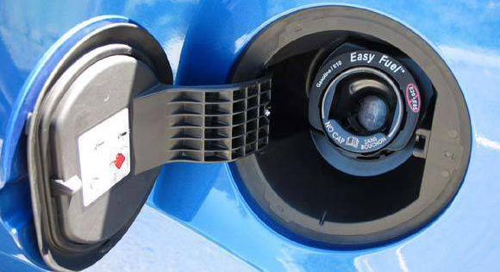
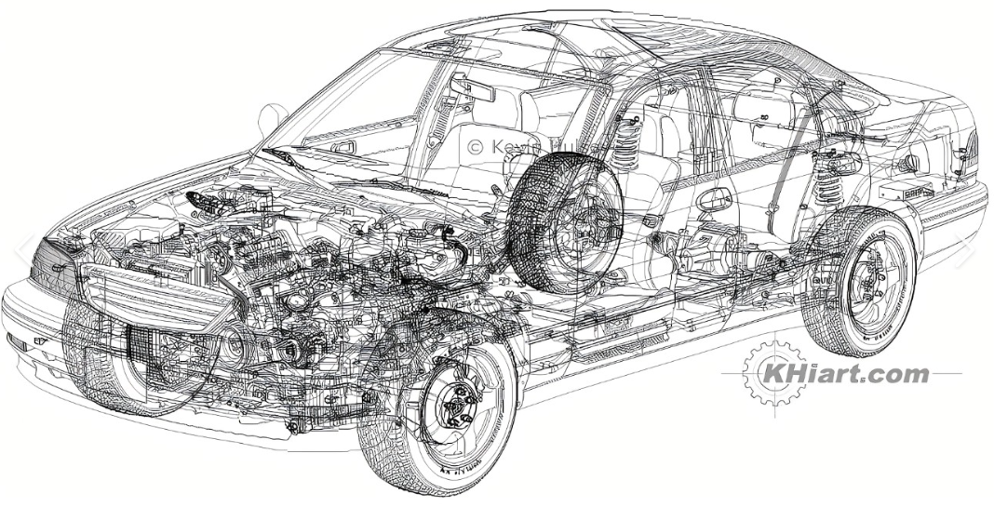
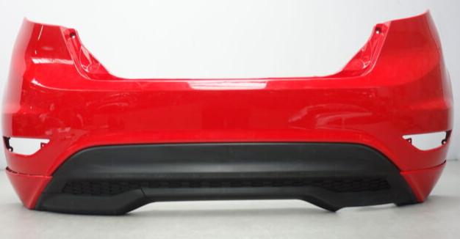
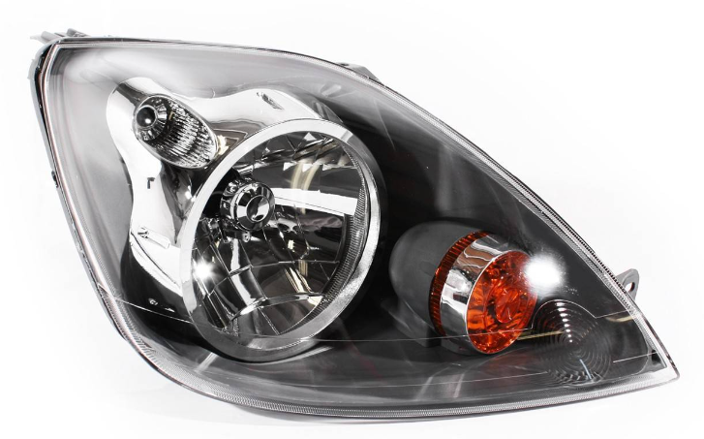
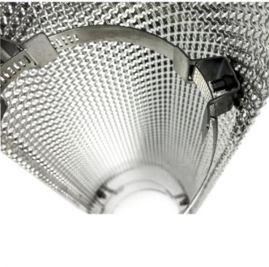
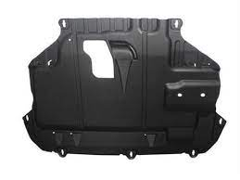
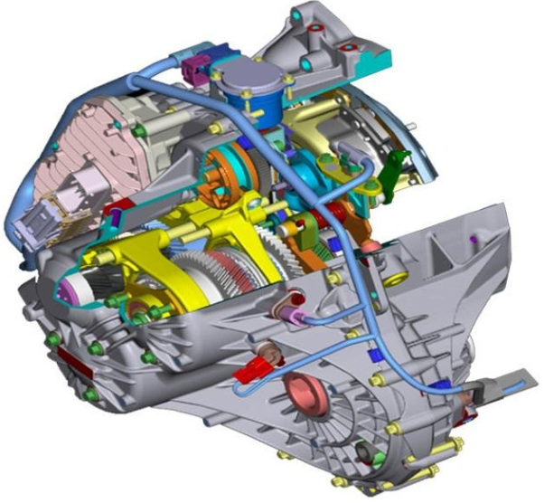
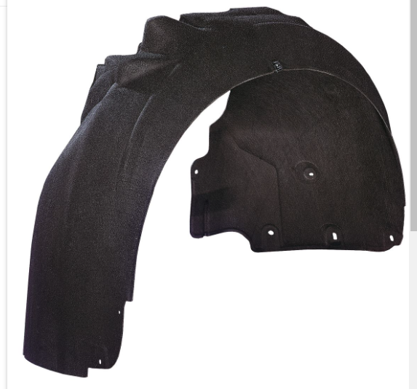
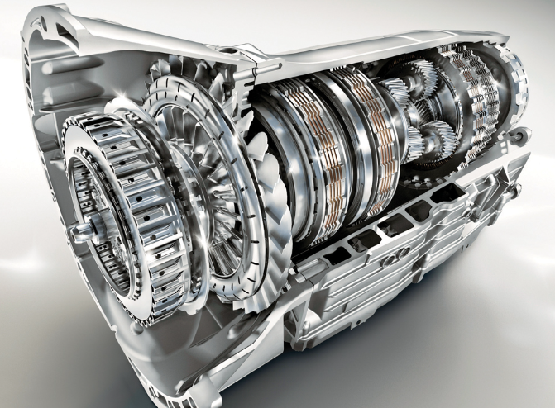
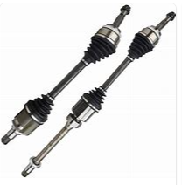
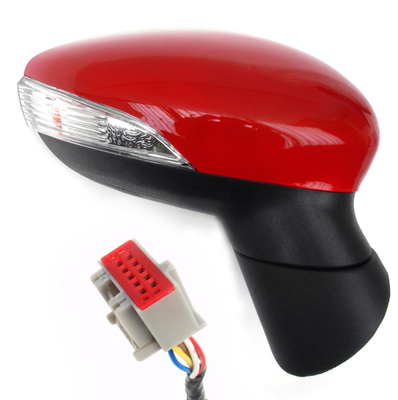
Previous Projects

Slide 3
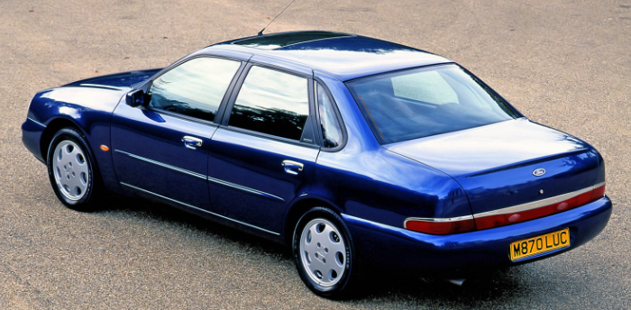
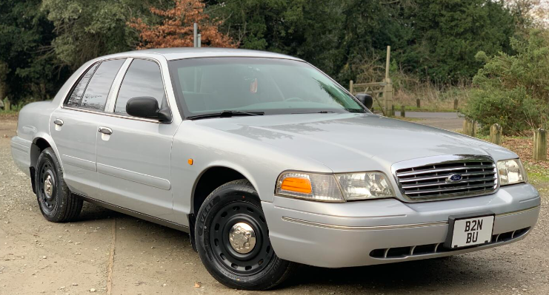
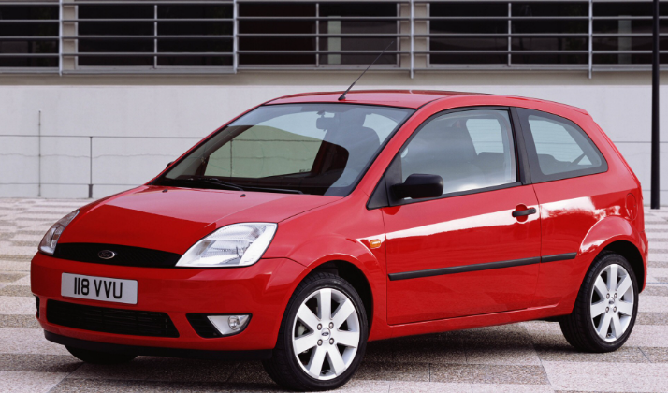
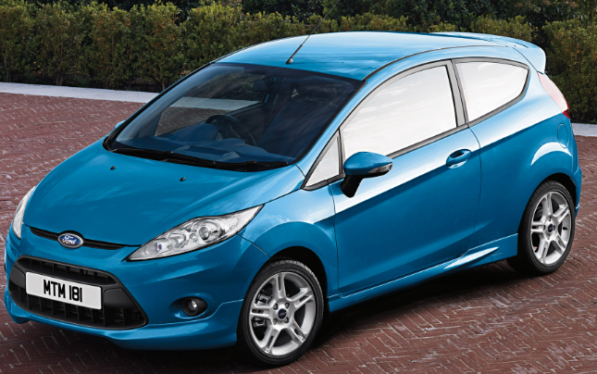
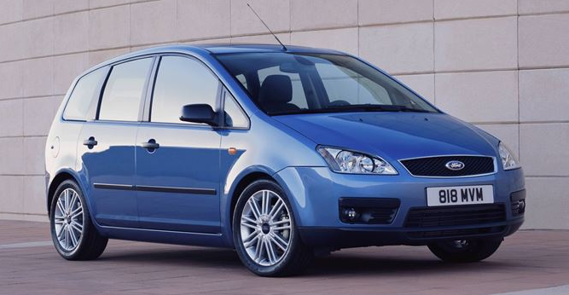
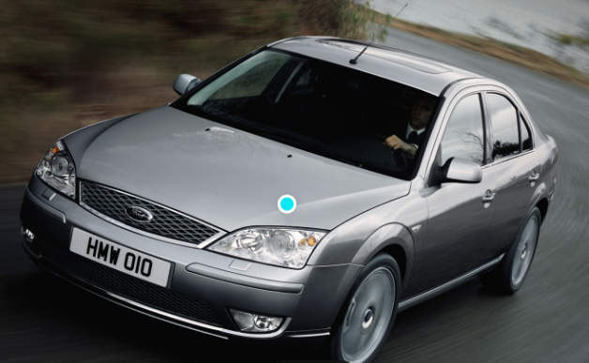
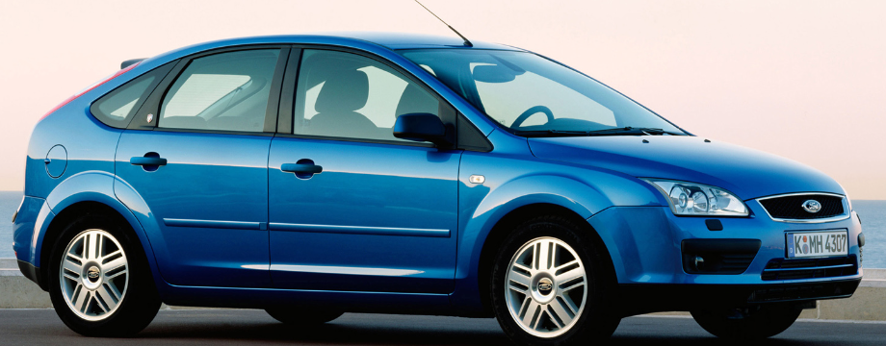
Previous Projects (and Countries visited)

Slide 4
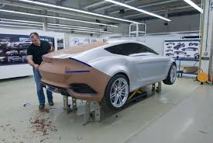
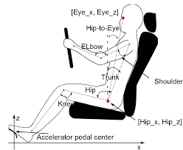
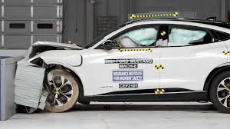
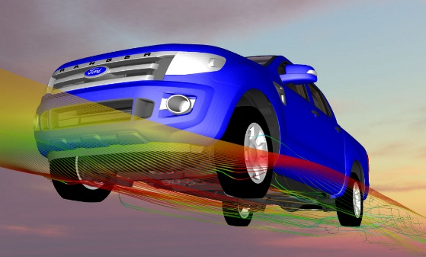
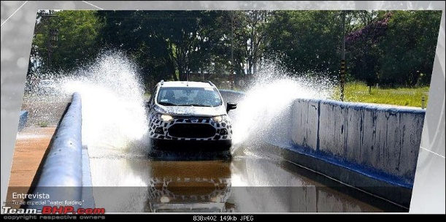
Day-to-Day Interfaces
Aerodynamics
Driveability and Vehicle Handling
Noise/ Vibration (NVH)
Manufacturing and Assembly
CAD/ CAE
Design
Styling and Design
Crash safety
Water Management
Ergonomics
Heat Management
Colour and Materials
Supplier Management
Vehicle and Component Testing
Senior Management Reviews
Finance
Purchasing

Slide 5
Ford Apprenticeships - Level 3 Engineering - Level 6 Engineering Degree - Level 6 Digital & Technology Solutions Degree

Slide 7
Level 3 Engineering Apprenticeship
BTEC Level 3 Extended Diploma in Manufacturing Engineering
Earn a salary of £14,274 whilst you learn!

Slide 8
Level 6 Degree Engineering Apprenticeship
Bachelor of Engineering (BEng)
Earn a salary of £24,533 whilst you earn!

Slide 9
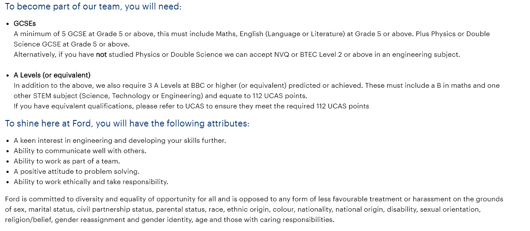
Level 6 Degree Engineering Apprenticeship (Cont’d)

Slide 10
Level 6 Digital & Technology Solutions Degree Apprenticeship
BSc (Hons) Degree in Digital and Technology Solutions
Earn a salary of £24,533 whilst you learn!

Slide 11
Level 6 Digital &Technology Solutions Degree (Cont’d)

Slide 14
Europe
New Fiesta
Puma
Mustang Mach-E
New Tourneo Connect
EcoSport
Tourneo Custom
New Focus
Ford GT
E-Transit
S-Max
Mustang

