Slide 1

Explore
careers in investment management

Slide 2


Slide 3


Slide 4


Slide 5


Environmental
Governance
Social

Slide 6

FUNDS
Investment manager
Financial analyst
Sales &distribution
Investment operations
And more…
COMPANY
Human resources
Accounting
Marketing and social media
Legal
And more…
TECH & SYSTEMS
Cybersecurity
Data engineer
Software engineer
Technology adoption
And more…

Slide 7











Product
specialists
build
investment
opportunities
Marketing
experts
promote to potential
& new clients
Client services support clients to understand
their
investments
Investment managers look after their
clients investments
Investment operations implement the end-to-end investment process
Analysts
research new
investment opportunities
Human resources manage, develop and support
the workforce
Technology enable global operation on sophisticated platforms
Compliance and legal ensure the company operate within regulatory rules
Finance and accountancy ensure the company is financially viable
Data provide critical information to help make business and investment decisions

Slide 8


Slide 9


Slide 10

Investment20/20 Programme
At least 12 month paid job ​
London starting salary £22,000 -£30,000 approx. ​
​
On the job training​
Possible industry qualification​
​
Development and networking events​
Notes:
England slide

Slide 11
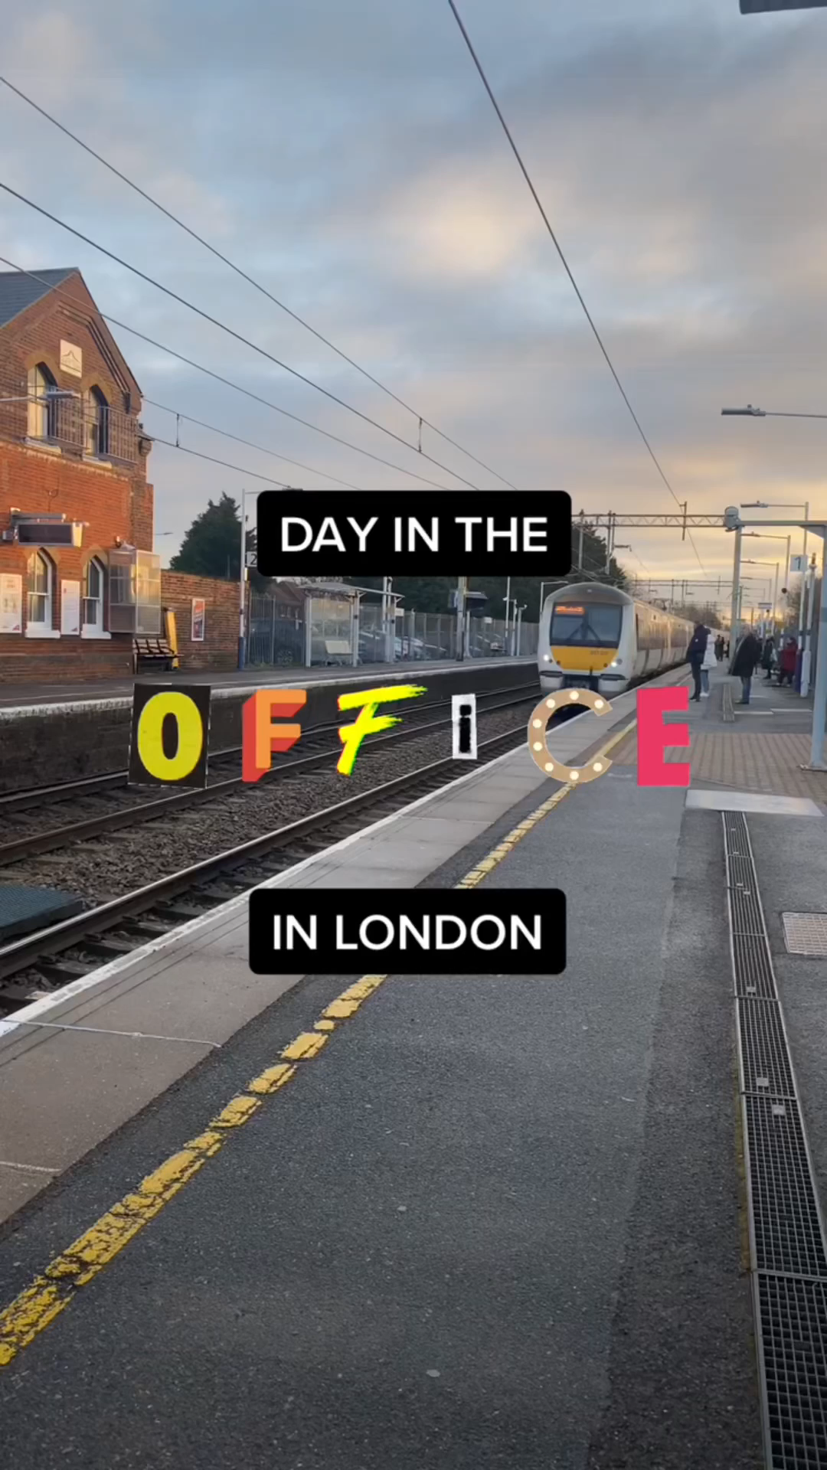

Slide 12


Register
with Investment20/20
Prepare your CV
and be open to feedback
Apply widely for different opportunities

Slide 13





































































Investment20/20 Employers

Slide 14





Registration
Instagram
Latest Jobs
TikTok
Scan here to register and to see our latest jobs

Slide 15

Thank you
investment2020.org.uk

