Slide 1
For ASK partner reference
Before this session, please:
Consider the audience you are delivering this to and adapt as necessary, including size of cohort, age group and for students with additional needs.
Check the videos have downloaded to your device and are embedded in the slide should you wish to include them.
Plan the session and adapt the slides as needed in terms of interactivity, internet/IT access and whether you will do any live demos of any websites.
Hide or unhide the appropriate slides depending on your audience, the length of session and delivery method e.g. virtual or face to face.
Note, the script is not designed to be read word for word – please include what is relevant and adapt the script to the needs of your audience as appropriate.
Add in local examples and local labour market information where required.
Ensure you refer to the interactivity slide deck and notes in the script to add interactive activities to your session.
Please review slide 2 for rough timings on each section of the session and adapt accordingly.
This presentation will roughly take 20 -25 minutes.
PLEASE ENSURE THIS SLIDE IS HIDDEN BEFORE PRESENTING

Slide 2
For ASK partner reference
Content
Intro (1-2 mins)
What are apprenticeships & benefits (5 mins)
Truth about apprenticeships (2-3 mins)
Range of apprenticeships & employers (2-3 mins)
Vacancy search (2-3 mins)
Finding an apprenticeship (2-3 mins)
Contact us / next steps (1-2 mins)

Slide 3
Introduction to apprenticeships
For students

Slide 4
Who knows nothing about apprenticeships?
Who feels confident they know what an apprenticeship is?
Who knows where you can apply for an apprenticeship?
Hands Up

Slide 5
By the end of today’s session, you should have a better understanding of:
Today’s aims
What apprenticeships are
The range of apprenticeship job roles available
The different levels
How you find an apprenticeship
What you need to do next to start searching and applying

Slide 6
Employed
Off the job
Intermediate – degree level
What are apprenticeships?
Paid a salary
Typically 1-6 years
Real responsibilities
600+ standards
Contract
Not the easy option

Slide 7
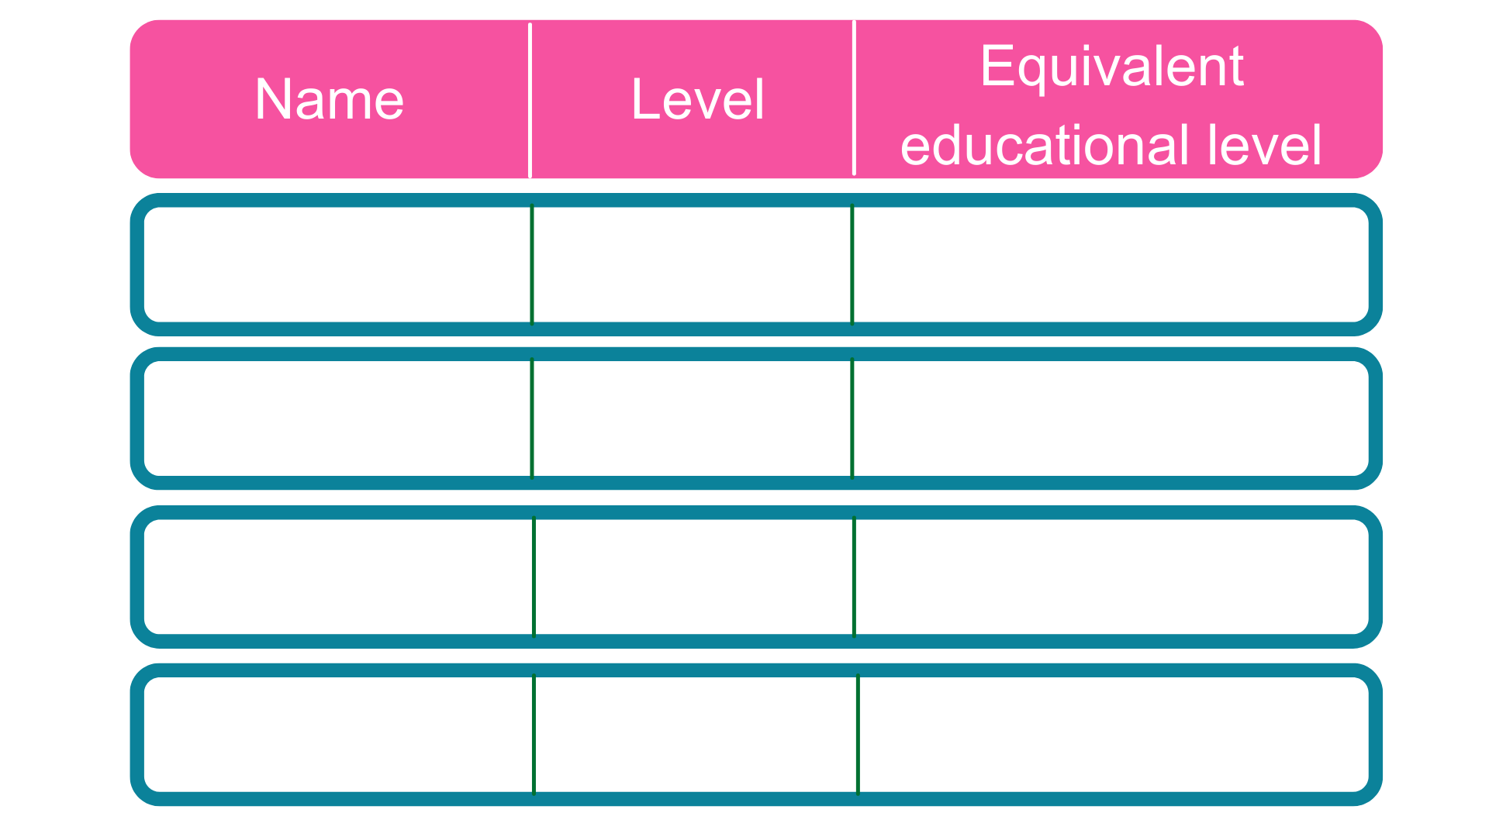
The levels of apprenticeships
Intermediate
2
5 GCSE passes at grade 4-9 (A*-C)
2 A Levels / Level 3 diploma / International Baccalaureate
Advanced
3
Higher
4,5,6 & 7
Foundation degree and above
Degree
6 & 7
Bachelor’s or master’s degree

Slide 8
12 career starter apprenticeships have been identified and guides have been created:
Freight Forwarding Specialist
Healthcare Support Worker
Engineering Fitter
Business Administrator
Information Communications Technician
Chef
Hospitality Team Member
Data or Software Technician
Electrician
Plumber
Teaching assistant
Early Years Educator
Career Starter Apprenticeships
With more coming in summer 2023:
Warehouse operative
Dental nurse
Digital support technician
Cyber security technician
Horticulture or landscape operative
Content creator
Bricklayer
Plasterer

Slide 9
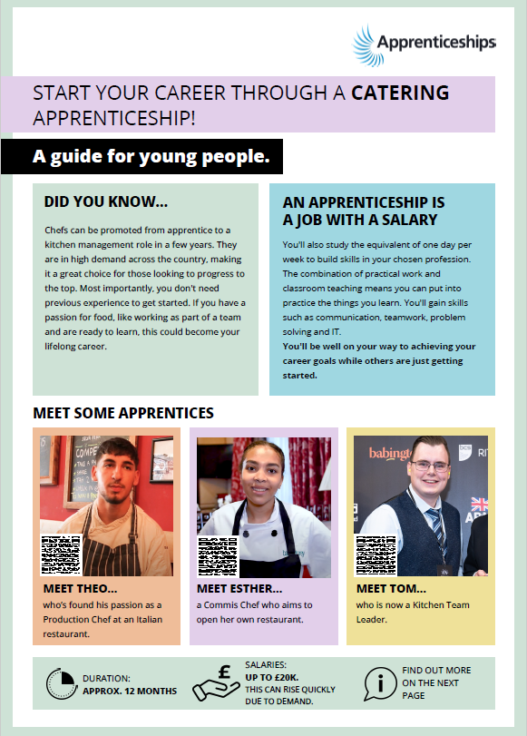
Employers offering the apprenticeship
General information
Career Starter Apprenticeship Guides
Hear more from apprentices themselves!
More detail
More information
Find all the guides here:
https://www.apprenticeships.gov.uk/apprentices/career-starter-apprenticeships

Slide 10
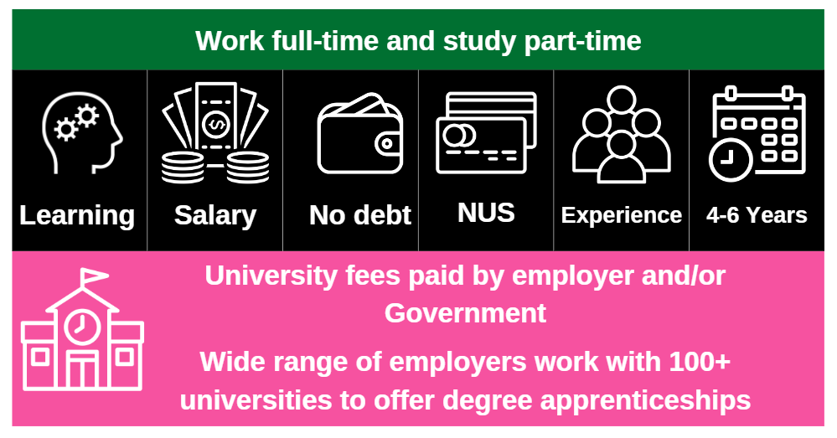
Higher & Degree apprenticeships

Slide 11
https://www.youtube.com/watch?v=guS6tQwU-tY
Hear from apprentices
Notes:
Presenter notes: Please make sure the film selected is downloaded and embedded into the slide.
We’ve covered quite a lot there already so I’m going to play you a short video now featuring apprentice name, who can bring this all to life a bit more by sharing their story of how they’re finding their apprenticeship and what they are doing.
Presenter notes: Please update the film included as you see best for your audience. For example, including a video of a local apprentice, including a World Skills Champion case study film or identifying a STEM apprentice or other suitable role model for your audience.
AAN story videos - https://www.apprenticeships.gov.uk/influencers/apprentice-ambassador-stories
World Skills UK ‘Skills Champion’ films - https://www.worldskillsuk.org/
Amazing Apprenticeships ‘Apprentices are Amazing’ film – https://vimeo.com/613415806
Amazing Apprenticeships ‘Apprentice Story’ films - https://amazingapprenticeships.com/apprentice-stories/
Understanding apprenticeships _ Full version (4m 41s) https://vimeo.com/151121127
Technology apprenticeships for the new generation (4m 22s) https://vimeo.com/158818858
Higher and degree apprenticeships – make them your plan A (2m 58s) https://vimeo.com/173753735
AAN vlogs – Saved in the ASK Teams folder

Slide 12
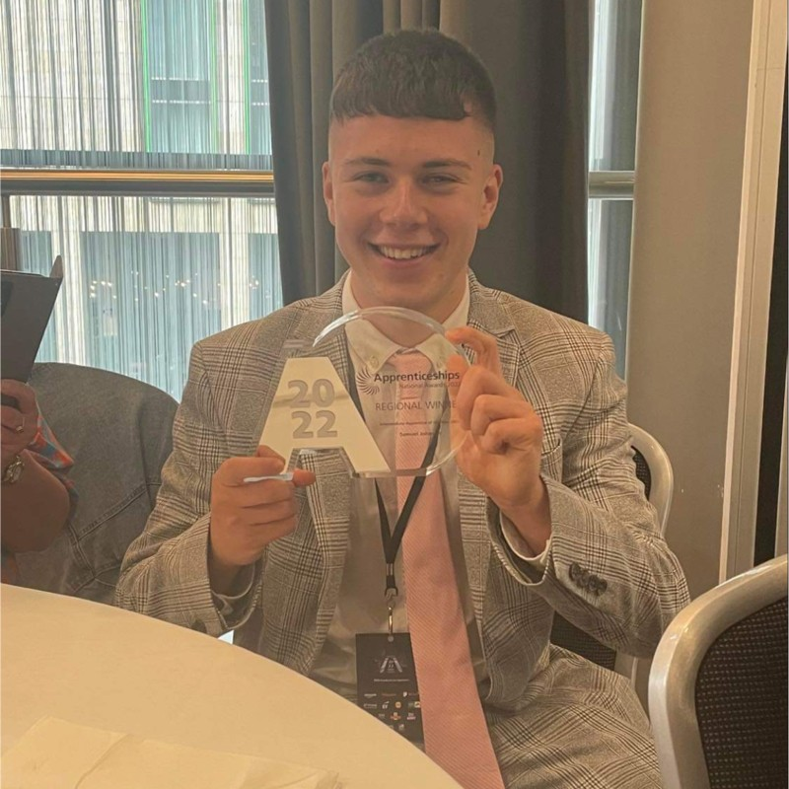
Meet some apprentices
Samuel - Level 2 Credit Controller Apprentice
Alicia – Level 3 Digital Marketing Apprentice
Anna - Level 4
Marketing Executive
Apprentices undertaking different level apprenticeships
Kelbydiamond - Level 5 Nursing Associate Apprentice
Parris - Level 6 Software Apprentice
Josh - Level 7 Solicitor Apprentice
Notes:
We’ve spoken about the different levels of apprenticeship, from levels 2 to 7, with a look at the career starter standards and then degree apprenticeships. Here are some real apprentices at each level, and the apprenticeships they are undertaking.

Slide 13
‘Apprenticeships are like university in that I can go anywhere in the country.’
There’s no limit in where you can do an Apprenticeship, but you must consider living costs before moving.
‘Apprentices won’t get to have fun or meet other young people.’
Myths and truths
You may meet other young apprentices within your work environment, and you will meet young people when you're at college/university whilst completing your studies.
‘Apprentices do so much more than making tea.’
You’re doing a real job across a variety of sectors making a real impact to your workplace.
‘Employers don’t offer jobs to apprentices once they have completed their apprenticeship.’
Around 90% of Apprentices stay are kept on within the business once completing their apprenticeship.

Slide 14
First Officer Pilot
Doctor
Hairdresser
Paralegal
Range of apprenticeships
Quantity Surveyor
Early Years Practitioner
Aerospace Engineer
Paramedic
Chef
Dietician
Beauty Therapist
Business Admin

Slide 15
Which employers offer apprenticeships?

Slide 16
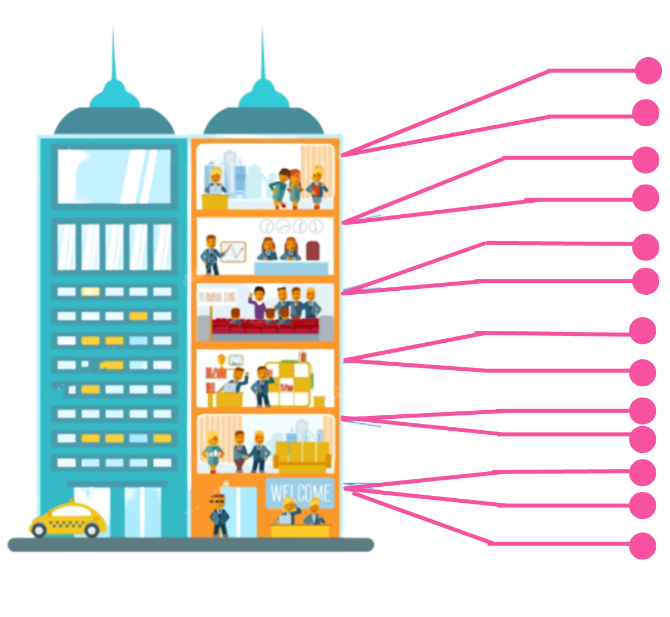
Logistics
IT & Cyber Security
Look inside the company
Data Analytics
Sales
Business Development
Marketing
Human Resources (HR)
Finance
Legal
Facilities Management
Security
Customer Service
Training & Development

Slide 17
Radius | Number of Vacancies
5 miles
33
Are there any vacancies?
10 miles
126
20 miles
714
30 miles
1482
England
8431

Slide 18
Name of Apprenticeship | Start date | Level | Annual Salary
IT Apprentice (3Gi Technology) 3Gi Technology Limited | 29th Apr 2024 | Advanced Level 3 (A Level) | £13,312.00
Apprentice Business Developer Howdens Joinery LTD | 14th May 2024 | Intermediate Level 2 (GCSE) | £15,000.00
Business Administration Apprentice Golden Thread Fire Delay LTD | 11th May 2024 | Advanced Level 3 (A Level) | £12,792.00
Chef Apprenticeship The George and Dragon Mountnessing. | 10th May 2024 | Intermediate Level 2 (GCSE) | £13,416.00
Apprentice Travel Consultant - Brentwood Hays Travel Limited | 12th Aug 2024 | Advanced Level 3 (A Level) | £Competitive
TONI&GUY Hairdressing Apprentice - Brentwood TONI&GUY Toni & Guy Brentwood | 02nd Sep 2024 | Intermediate Level 2 (GCSE) | £10,982.40
Early Years Educator Level 3 Apprenticeship Woodlands Schools Brentwood | 13th May 2024 | Advanced Level 3 (A Level) | £10,982.40
Closing date
Annual salary
Apprenticeships in the local area

Slide 19
How do you find apprenticeships

Slide 20
Alternative places to find an Apprenticeship
UCAS
Meet the Employer
Company Websites
Social Media, Friends & Family

Slide 21
Hear from apprentices
Notes:
Presenter notes: If you have an apprentice ambassador with you, please replace this slide with their presentation.
Delivery partner to insert film of their choice about apprenticeships.
We would recommend that you download the film onto a memory stick and take it with you.
Some establishments will not have sufficient internet access.
AAN story videos - https://www.apprenticeships.gov.uk/influencers/apprentice-ambassador-stories
World Skills UK ‘Skills Champion’ films - https://www.worldskillsuk.org/
Amazing Apprenticeships ‘Apprentices are Amazing’ film – https://vimeo.com/613415806
Amazing Apprenticeships ‘Apprentice Story’ films - https://amazingapprenticeships.com/apprentice-stories/
Amazing Apprenticeships ‘Green Apprenticeships’ film - https://amazingapprenticeships.com/resource/green-apprenticeships-film/
Understanding apprenticeships _ Full version (4m 41s) https://vimeo.com/151121127
Technology apprenticeships for the new generation (4m 22s) https://vimeo.com/158818858
Higher and degree apprenticeships – make them your plan A (2m 58s) https://vimeo.com/173753735
AAN vlogs – Saved in the ASK Teams folder

Slide 22
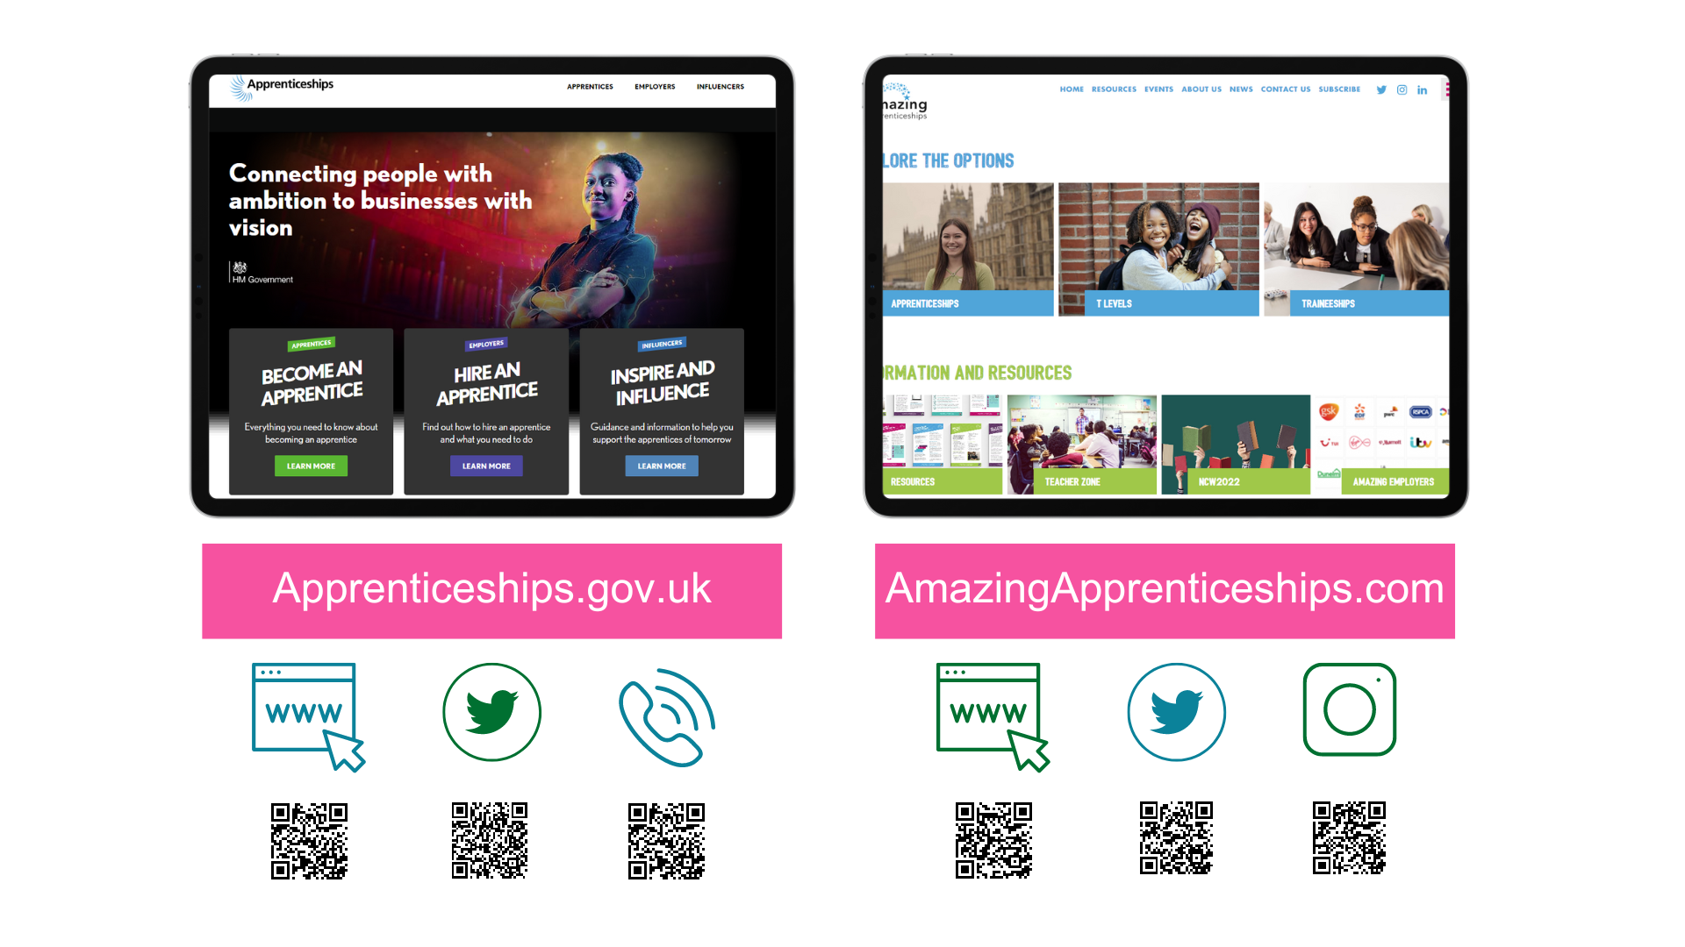
Contact us
amazing

Slide 23
Notes:
You can visit the National Careers Service website to find out about all of the education and training options available to you once you’ve finished school.
The website gives you information about 8 different options:
3 x study options
A Levels
University (Higher Education)
Higher Technical Qualifications
2 x work options
School leaver schemes
Supported internships
3 x work and study options
Apprenticeships
T Levels
Vocational Technical Qualifications (VTQs)
The website helps to explain what the different options are, how they are similar/different to each other, who they are for and where to find out more information
You can find the website through the link on the slide or by scanning the QR code - https://nationalcareers.service.gov.uk/explore-your-education-and-training-choices
On the website, you will also find contact details for how to get in touch with their advisers through the helpline.

Slide 24
Who knows more about apprenticeships than they did at the beginning?
Who feels confident they know what an apprenticeship is?
Hands Up
Is anyone going to research apprenticeships or considering them as an option now?
Who confidently knows where to search and apply for apprenticeships now?

Slide 25
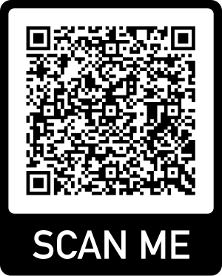
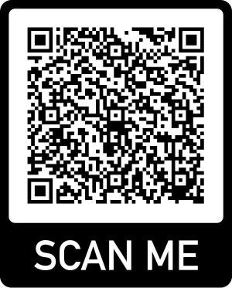
Student/Young person
Feedback form
Student/Young person
Feedback form
Schools, Colleges and Teachers Feedback form
Student evaluation form

Slide 26
Student/Young person
Feedback form
Student/Young person
Feedback form
Schools, Colleges and Teachers Feedback form
Student evaluation form
Notes:
Presenter notes: Please unhide this slide to be included where appropriate. This slide will be hidden by default.

Slide 27
Thank you for listening. Any questions?
Any questions
Notes:
But for now, are there any questions at all?
Suggested interactivity: Please do another poll/raise of hands to gauge understanding at the end of the session:
Hopefully you all now have a better understanding of what an apprenticeship is, so please can you raise your hands/complete the poll again to indicate if you now think that you know a little bit / a lot / nothing about apprenticeships?
Thank you so much again for all of your engagement and input today. I’m really excited for you all as you think about your next steps and begin looking at all of the different opportunities open to you.
For any further questions, please pass them onto your teacher and we can follow up with them afterwards.

Slide 28
Anything to promote?
Notes:
Presenter notes: Any further call to actions should be included here:
Book onto the next session e.g. reg workshop
Let us know if you make an application
Upcoming event – e.g. Spotlight talks (World Skills), NAW, NAAs etc
Please complete our short survey
Close session
This slide will be hidden as a default so please unhide it should you need to include any information.

